Slide 1
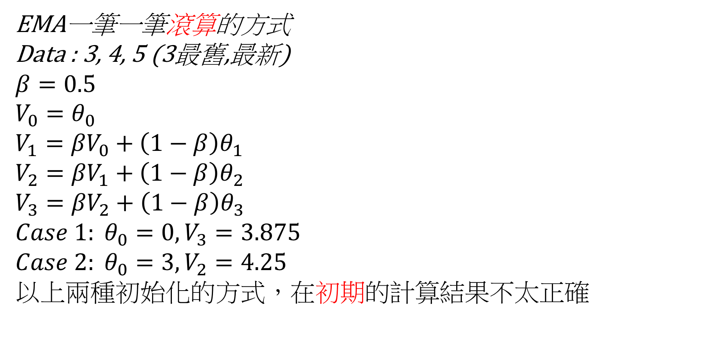
EMA一筆一筆滾算的方式
Data : 3, 4, 5 (3最舊,最新)
$$β=0.5$$
$$V_{0}=θ_{0}$$
$$V_{1}={βV}_{0}+\left(1−β\right)θ_{1}$$
$$V_{2}={βV}_{1}+\left(1−β\right)θ_{2}$$
$$V_{3}={βV}_{2}+\left(1−β\right)θ_{3}$$
$${Case 1: θ}_{0}=0, V_{3}=3.875$$
$${Case 2: θ}_{0}=3, V_{2}=4.25$$
以上兩種初始化的方式，在初期的計算結果不太正確

Slide 2
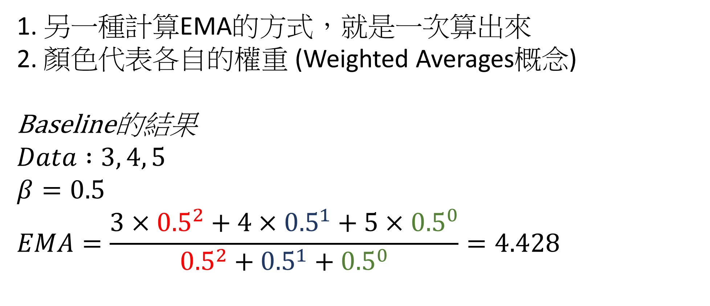
1. 另一種計算EMA的方式，就是一次算出來
2. 顏色代表各自的權重 (Weighted Averages概念)
Baseline的結果
$$Data :3, 4, 5$$
$$β=0.5$$
$$EMA=\frac{3×{0.5}^{2}+4×{0.5}^{1}+5×{0.5}^{0}}{{0.5}^{2}+{0.5}^{1}+{0.5}^{0}}=4.428$$

Slide 3
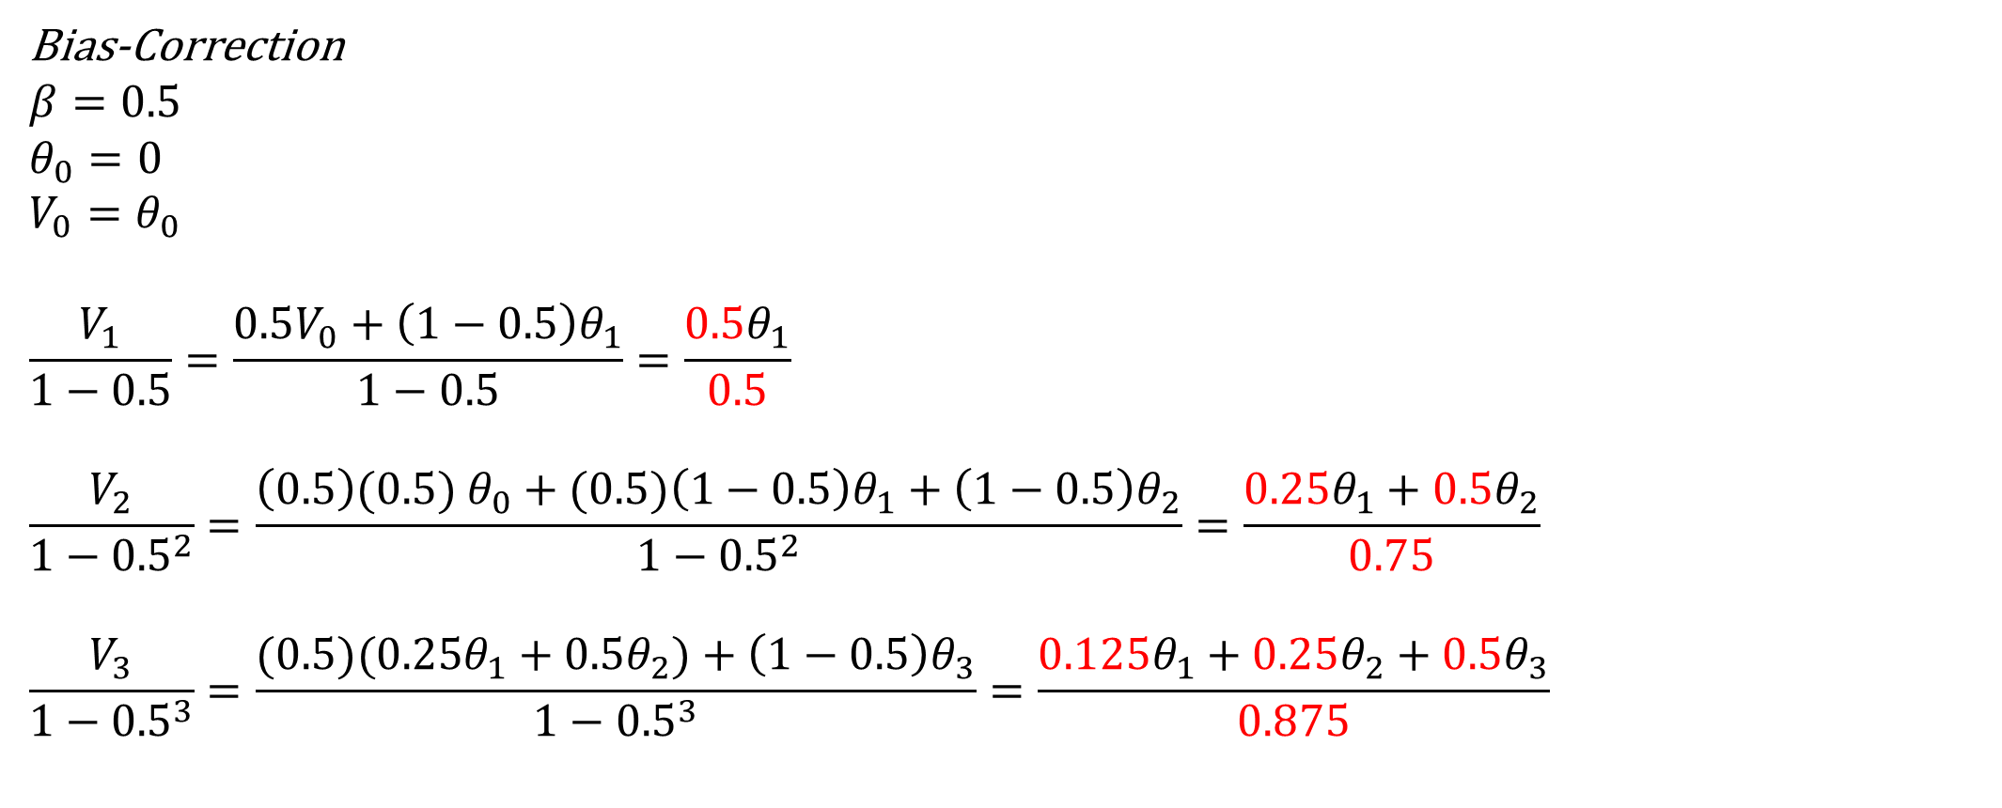
Bias-Correction
$$β=0.5$$
$$θ_{0}=0$$
$$V_{0}=θ_{0}$$
$$\frac{V_{1}}{1−0.5}=\frac{{0.5V}_{0}+\left(1−0.5\right)θ_{1}}{1−0.5}=\frac{0.5θ_{1}}{0.5}$$
$$\frac{V_{2}}{1−{0.5}^{2}}=\frac{{\left(0.5\right)(0.5) θ}_{0}+(0.5)\left(1−0.5\right)θ_{1}+\left(1−0.5\right)θ_{2}}{1−{0.5}^{2}}=\frac{0.25θ_{1}+0.5θ_{2}}{0.75}$$
$$\frac{V_{3}}{1−{0.5}^{3}}=\frac{(0.5)(0.25θ_{1}+0.5θ_{2})+\left(1−0.5\right)θ_{3}}{1−{0.5}^{3}}=\frac{0.125θ_{1}+0.25θ_{2}+0.5θ_{3}}{0.875}$$

